Slide 1

Git and GitHub
Begginer Guide
ADAS

Slide 2
Overview
Install git and create GitHub account.
What is git?
How does git works?
What is GitHub?
Quick example using git and GitHub.

Slide 3
Install Git and create a GitHub Account.
Install git
Linux (Debian)
  Command: sudo apt-get install git
Linux (Fedora)
  Command: sudo yum install git
Mac
  https://git-scm.com/download/mac
Windows
  https//git-scm.com/download/win

Slide 4
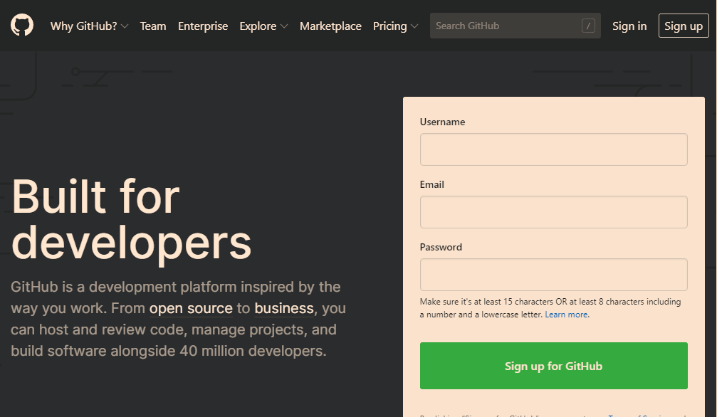
Create GitHub account
www.github.com
Free for public repositories

Slide 5
What is a version control?
A system that keeps records of your changes.
Allows for collaborative development.
Allows you to know who made what changes and when.
Allows you to revert any changes and go back to previous state.

Slide 6

What is git?
What is version control?
  Distributed version control
  User keep entire code and history on their location machines
  User can make any changes ithout internet access
  (Except puhing and pulling changes from a remote server)
What is git?
  Stated in 2005
  Created by Linus Torvald to aid in Linux kernel development

Slide 7




What is git?
Git isn’t the only version control system.
But it’s the most convenient to current projects.

Slide 8
How does git work?
Could be complicated at first but there are main concepts to help us to undestand git process.
Important git terminology in following slides are in blue.

Slide 9
Key concepts: Snapshots
The way git keeps track of your code history.
Essentially records what all your files look like at the given point of time.
You decide when you take a snapshot, and of what files.
Have the ability to back to visit any snapshot
  Your snapshots from later on Will stay around, too

Slide 10
Key concepts: Commit
The act of creating and snapshot.
Can be a noun or verb
  “I commited code”
  “I jus made a new commit”
Esscentially, a full project is made up of a bunch of commits.

Slide 11
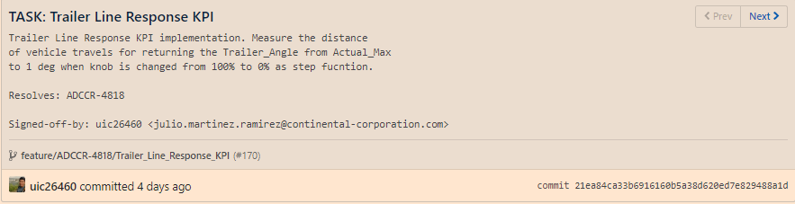
Key concepts: Commit
Commits contain three pieces of information:
  Information about how the files changed from previously.
  A reference to the commit that came before it:
    “Called parent commit”
  A hash code name:
    Will look something like:

Slide 12
Key concepts: Repositories
Often shortened to “repo”
A collection of all the files and the history of those files
  Consist of all your commits
  Place where all your hard work is stored
Can live on local machine or on a remote server (GitHub)
The act of copying a repository from a remote server is called cloning
Cloning from a remote server allows team to work together

Slide 13
Key concepts: Repositories
The process to downloading commits that don’t exist on your local machine from a remote server repository is called pulling changes.
The process of adding your local changes to the remote repository is called pushig changes.

Slide 14
Key concepts: Branches
All commits in git live n some branch
But there can be many, many branches
The main branch in a project is called the master branch

Slide 15
So what does a typical project look like?
A bunch of commits linked togueter that live in some branch, contained in a repository.
Following images taken and modified from:
  https://marklodato.github.io/visual-git-guide/index-en.html
  Also a good tutorial!

Slide 16
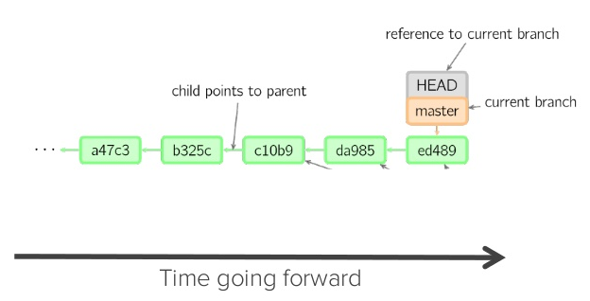
So, what does a tipical project look like?

Slide 17
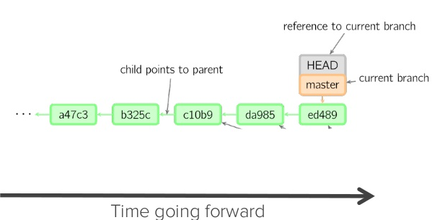
So, what is HEAD?
A reference to most recent commit
(In most cases- not always truth)

Slide 18
So what’s the MASTER?
The main branch in your project
Doesn’t have to be called master, but almost always is!

Slide 19
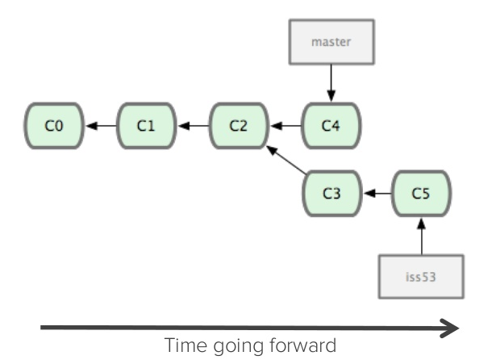
Key concepts: Branching off the master branch
The start of a branch points to a specific commit
Whn you wnat to make any changes to your Project you make a new branch based on commit

Slide 20
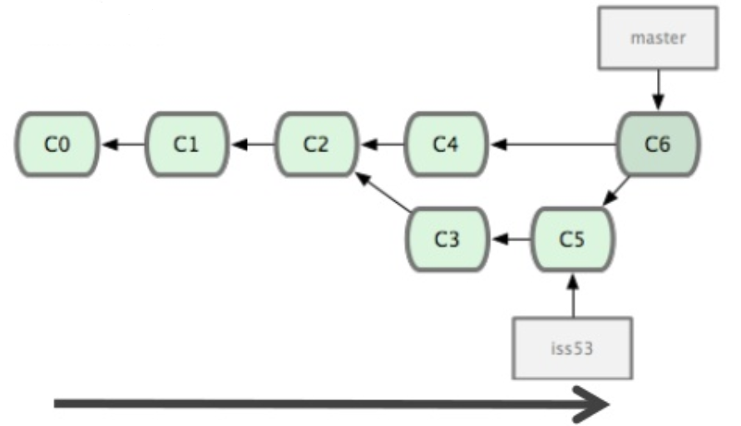
Key concepts: Merging
Once you are done with your feature, you merge back into master

Slide 21
Key concepts: How do you make a commit anyway?
There are a lot of ‘states’ and ‘places’ a file can be.
Local on your computer: the “working directory”
When a file is ready to be put in a commit you add it onto the “index” or “staging”
  Staging is the new preferred term but you can see both “index” and “staging” being used

Slide 22
Key concepts: How do you make a commit anyway?
The process:
  Make some changes to a file
  Use the “git add” command to put the fileonto the staging enviroment
  Use “git commit” command to create a new commit

Slide 23
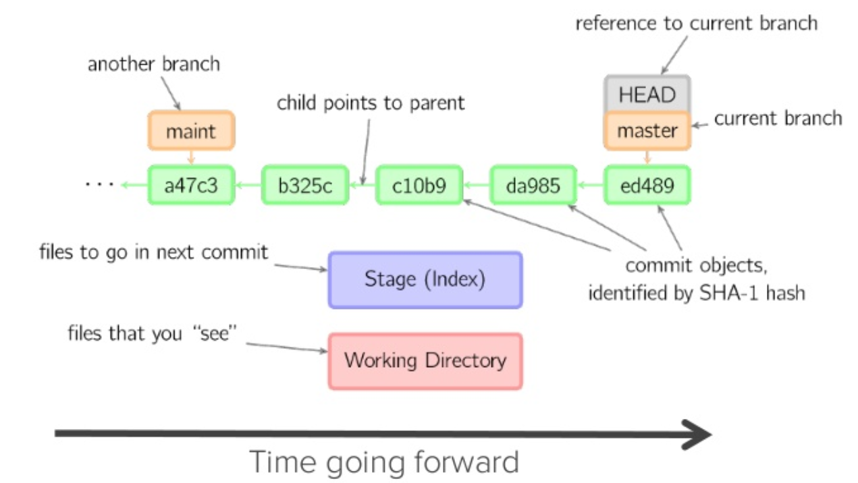
Key concepts: How do you make a commit anyway?

Slide 24
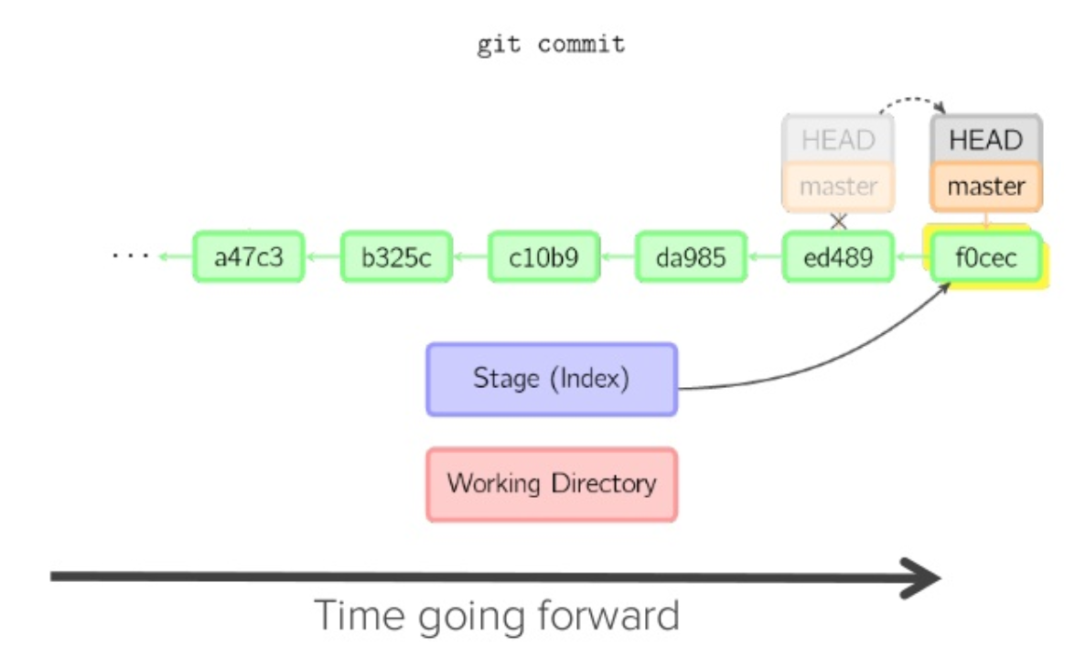
Key concepts: How do you make a commit anyway?

Slide 25

What is GitHub?
www.github.com
Largest web-based git repository hosting a service
  Host ‘remote repositories’
Allows for code collaboration with anyone online
Add extra functionality on top of git
  UI, documentation, bug tracking, feature request, pull request and more!
Founded in 2008

Slide 26
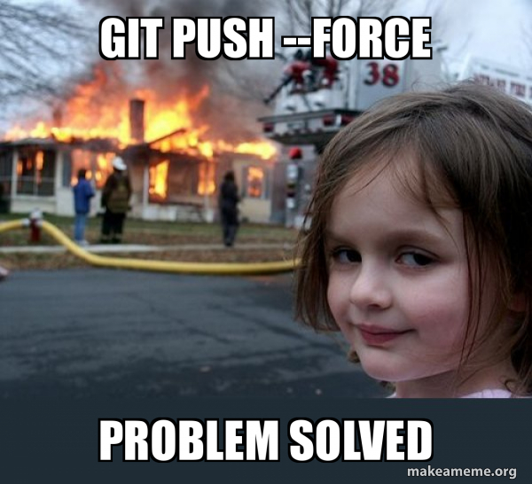
Tips and tricks! …and chips
$ git push -u origin feature/ADCCR-2955/VStop_review_test

Slide 27
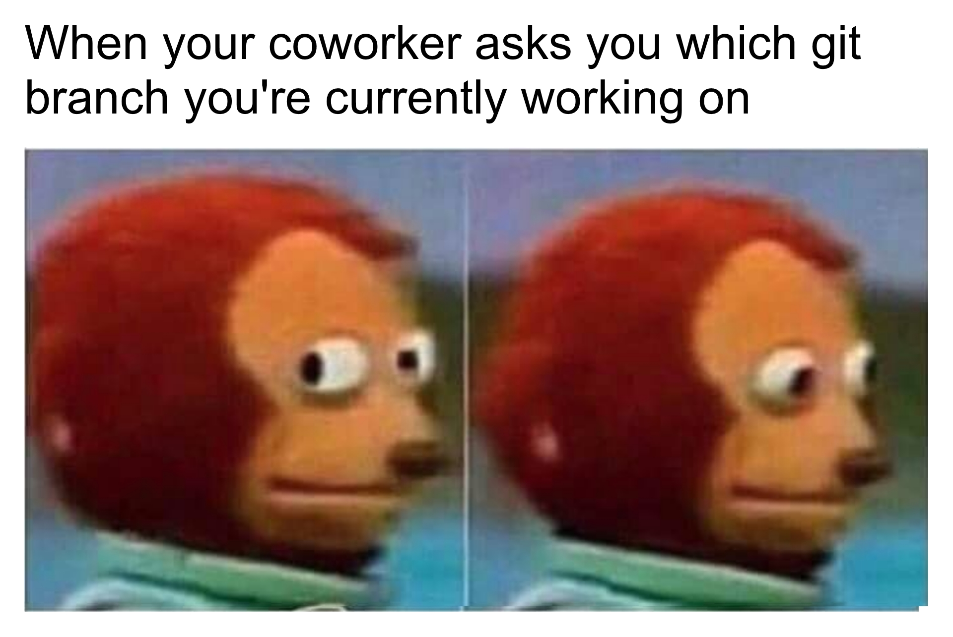
Always work in feature branch/issues
$ git checkout -b feature/ADCCR-2955/VStop_review_test

Slide 28
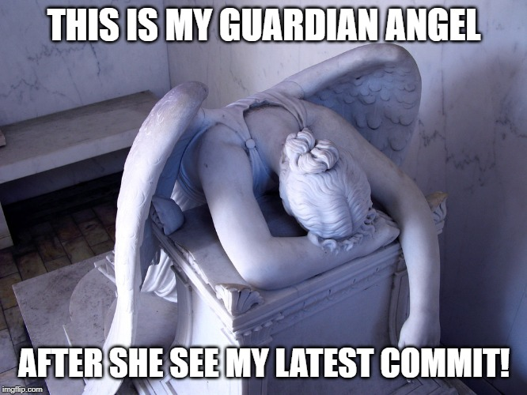
$ git commit -s

Slide 29
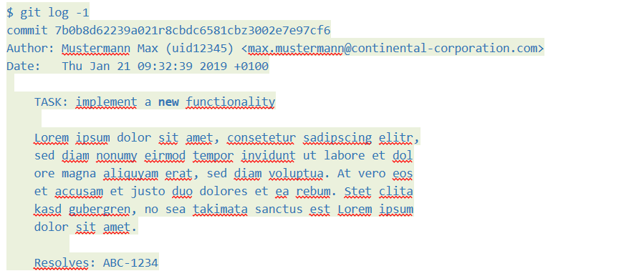

Slide 30
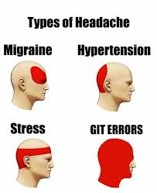

Slide 31

Never stop learning!

